Slide 1


2020
Shopping Everyday
Team：YanBingjie Jayce，WangNan Bonnie，TengChang Krystal，NiuCong Daniel
Assistance：Rupali、Abhijeet、Deliucia
Hainu University NIIT·ISAS

Slide 2
1 Special thanks
2 Use of technology
CONTENTS
3 Generate logs into HBase
4 Analysis logs
5 Data export & exhibition

Slide 3
1
Special thanks
step 1

Slide 4
1
Special thanks
Thanks for all of you!
In the process of making difficult projects, we have received help from many people. Teachers Liu Decai, Rupali, Abhijeet, and all the students and relatives who have provided ideas, ideas, and help for our project have given us technology And provide great help emotionally.
We would like to express our sincere gratitude to everyone who helped us to overcome the difficulties and accompany us through this boring and fun day.

Slide 5
2
Use of technology
step two

Slide 6





2
Use of technology
operating system
database
usage
Database connection driver
data analysis
server
Windows、Linux
Mysql、HBase
Apache Tomcat
Java web IDE
Hive
JSP Compared with JavaScript: Although JavaScript can dynamically generate HTML on the client side, it is difficult to interact with the server, so it cannot provide complex services such as database access and image processing.
Compared with static HTML: Static HTML does not contain dynamic information.
Hadoop MapReduce is a software framework based on which you can easily write applications that can run on large clusters of thousands of business machines and process them in a reliable, fault-tolerant manner in parallel Massive datasets on the terabyte level. There are these keywords in this definition,

Slide 7
3
Generate logs into HBase
step 3

Slide 8
3
Generate logs into HBase
For the log files generated on the front end, use NetBeans to import directly into HBase
Created a structured framework of two imported tables and eight exported tables on hive
HBase and HIVE integration

Slide 9
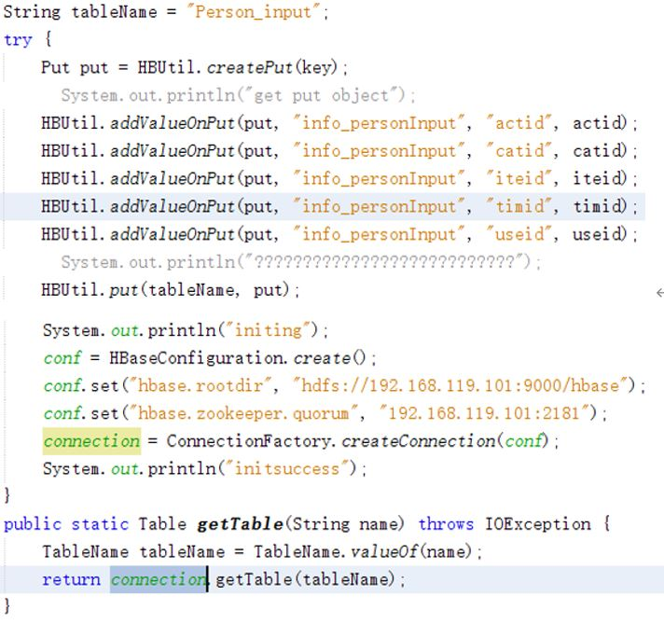
3
Import log files generated on the front end into HBase
For the log files generated on the front end, we will use NetBeans to import directly into HBase;
The following sections are the code to import the log files generated by the front end.

Slide 10
3
Imports the web log files into HBase
For the web log files, we use hive statement imports.
The following sections are the code to import the web log files.
load data：
create table Intel_input_temp(useid int, iteid int, catid int, actid int, time int)
ROW FORMAT DELIMITED FIELDS TERMINATED BY ',’;
load data local inpath '/home/hadoop/misc/intel_data.csv' into table Intel_input_temp;
insert overwrite table Intel_input select * from Intel_input_temp;

Slide 11
4
Analysis logs
step 4

Slide 12
4
Analysis logs
We use Hive statements to analyze log files. (since the web log files are analyzed in the same way as our own generated log files, our log analysis details will be interpreted uniformly).
(1)Most popular item
We make block statistics for each data in the table through "Group by", then reverse order all statistics with "Order by DESC", and select the top 5 statistics with "Limit 5", and finally get the 5 commodities with the most clicks.
insert into table intel_outputclick
select row_number() over(partition by 1), ff.* from
(select f.* from (select iteid, count(*) c from
intel_input group by iteid
order by c desc limit 5)f order by f.c)ff;

Slide 13
4
Analysis logs
(2) Best shell top
We used “Group by” to block every “actid=1” data in the table, then used “Order by DESC” to reverse sort all statistics, and “Limit 5” to filter the first 5 statistics, and finally got the top 5 goods sold.
(3) Buy rate
For each item in the table, we first added up the number of items with an attribute of "actid" with a value of 1, then multiplied by the number of items, to get the top five items with the highest purchase.
insert into table intel_outputBuy
select row_number() over(partition by 1), ff.*
from (select f.iteid, f.rate
from (select iteid, sum(catid)/count(catid) rate
from Intel_input group by iteid
order by rate desc limit 5)f order by f.rate) ff;
insert into table intel_outputclick
select row_number() over(partition by 1), ff.* from (select f.* from (select iteid, count(*) c from intel_input group by iteid
order by c desc limit 5)f order by f.c)ff;

Slide 14
5
Data export & exhibition
step 5

Slide 15
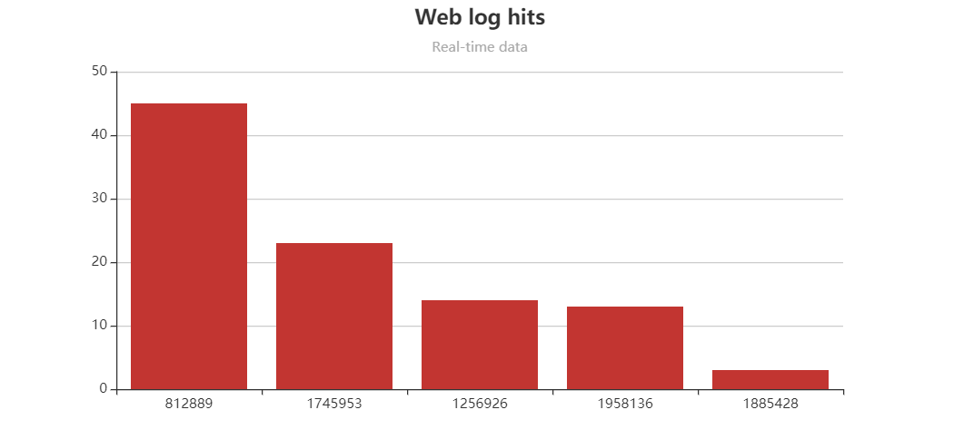
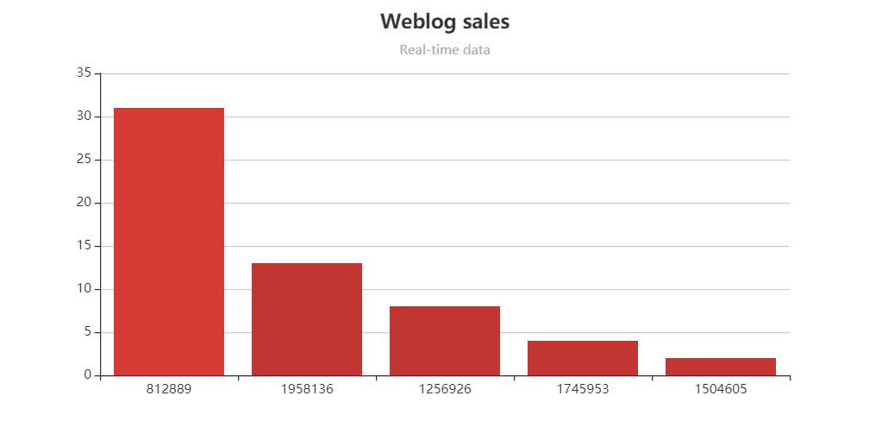
5
Data export & exhibition
Obtain data from the front end：
We use NetBeans to connect to HBase, turn the result into JSON data, take it out and put it into a FRONT-END JSP file as a parameter to construct the dynamic diagram. The final result is shown in the figure below:

Slide 16
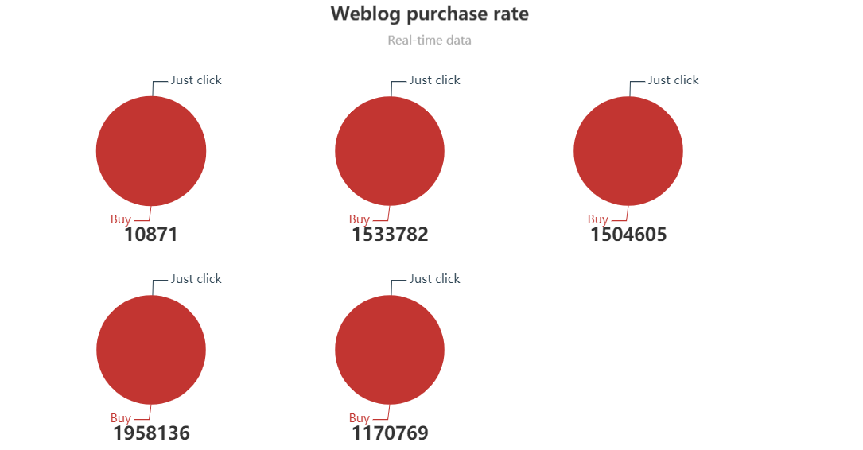
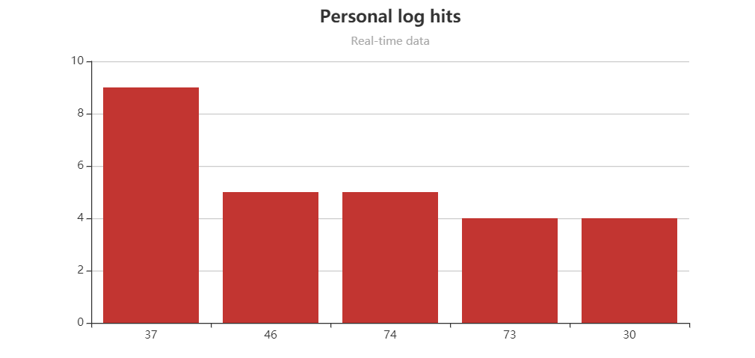
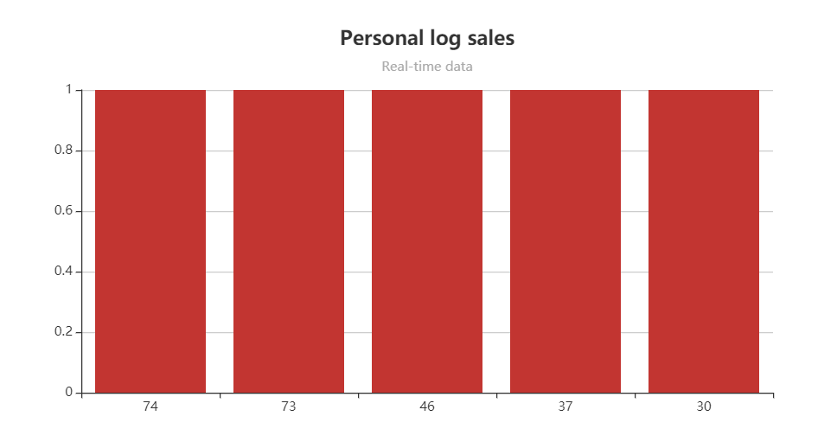
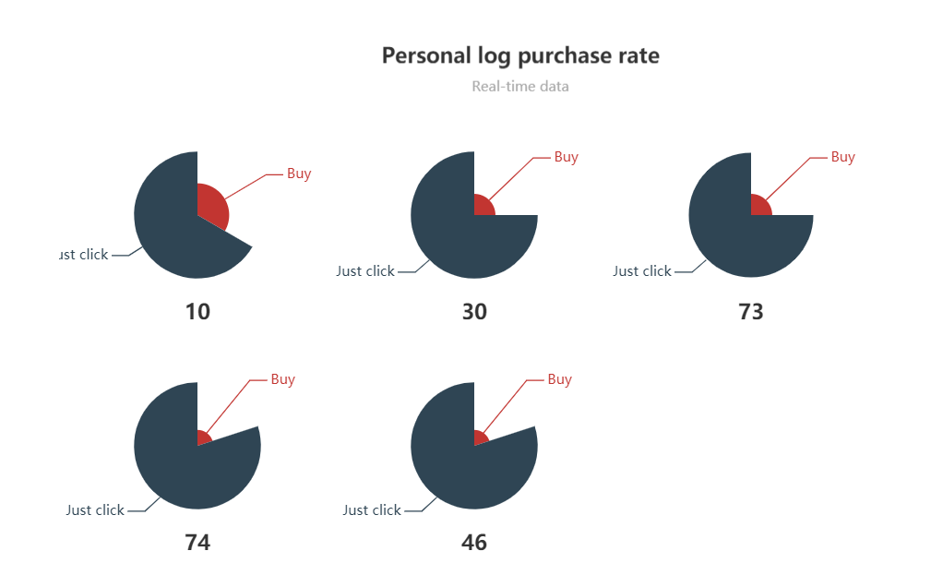
5
Data export & exhibition

Slide 17
THANKS!
Shopping Everyday
Team：YanBingjie Jayce，WangNan Bonnie，TengChang Krystal，NiuCong Daniel
Assistance：Rupali、Abhijeet、Deliucia
Hainu University NIIT·ISAS

